Slide 1
Merge Sort
Void main(){
int *arr = new int[12] {55, 6, 3, 1, 89, 34, 22, 5, 4, 11, 7, 67};
MergeSort *rp = new MergeSort();
rp->sort(arr, 12);
}

Slide 2
Merge Sort
void MergeSort::sort(int *arr, int size) {
int *left = NULL;
int *right = NULL;
if (size > 1) {
// split the array into two pieces, as close to the same
// size as possible.
left = split(arr, 0, size / 2);
right = split(arr, size / 2, size);
// sort each of the two halves recursively
sort(left, size / 2);
sort(right, size / 2);
}
// merge the two sorted halves together
merge(arr, left, right, size / 2, size / 2);
}

Slide 3
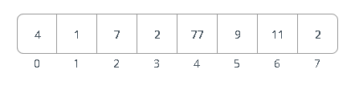
Merge Sort Example
Our Starting point
Divide - recursively divide the array in half until we get to the anchor
Recur - sort the two halves into the original array
Conquer -

Slide 4
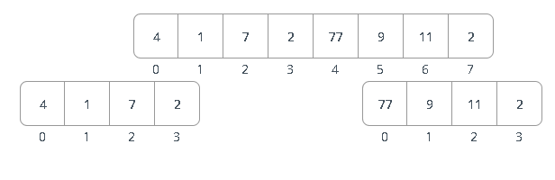
Divide
Split the array into left and right
int* MergeSort::split(int *arr, int start, int last) {
int *ret = new int[last - start];
for (int i = 0; i < (last - start); i++) *(ret+i) = *(arr + (start + i));
return ret;
}

Slide 5
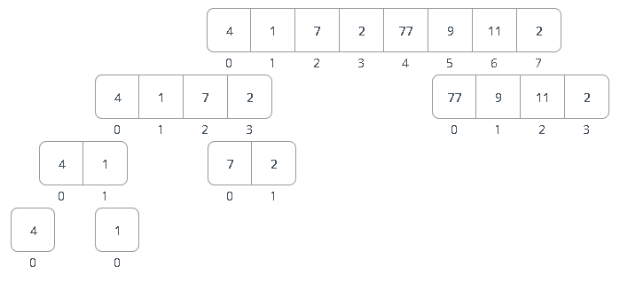
Anchor – size of split array is 1

Slide 6
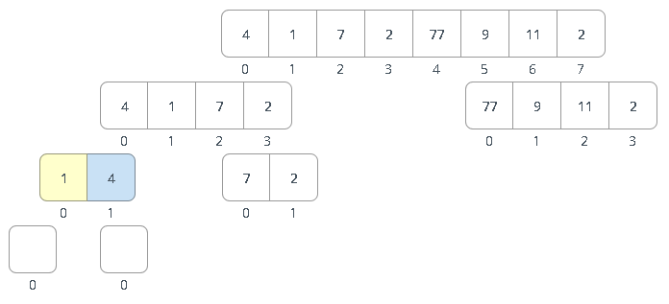
Now sort the array back to the array we just split
merge(arr, left, right, size / 2, size / 2);

Slide 7
Merge Sort
void MergeSort::sort(int *arr, int size) {
int *left = NULL;
int *right = NULL;
if (size > 1) {
// split the array into two pieces, as close to the same size as possible.
left = split(arr, 0, size / 2);
right = split(arr, size / 2, size);
// sort each of the two halves recursively
sort(left, size / 2);
sort(right, size / 2);
}
// merge the two sorted halves together
merge(arr, left, right, size / 2, size / 2);
}

Slide 8
The merge
void MergeSort::merge(int *dest, int *left, int *right, int leftsize, int rightsize) {
int i = 0;
int j = 0;
int dindex = 0;
while (i < leftsize && j < rightsize) {
if (*(left + i) < *(right + j)) {
*(dest + dindex) = *(left + i);
++i;
}
else {
*(dest + dindex) = *(right + j);
++j;
}
dindex++;
}
for (; j < rightsize; j++) {
*(dest + dindex) = *(right + j);
dindex++;
}
}
for (; j < rightsize; j++) {
*(dest + dindex) = *(right + j);
dindex++;
}

